Slide 1
Fast Food Analysis
By Group ID : PTID-CDA-JUL-24-184

Slide 2
Contents
Introduction
About Dataset
Task Given By PAT team
Tools
Steps of solving tasks
Dashboard
Report

Slide 3
Introduction
Worlds largest growing food type is fast food
Industry growth for fast food is 40% per year
MC Donald is the leader in Indian fast food chain
Fast food is the term given for food that prepare quickly

Slide 4
About Dataset
The given Dataset consist of fast food supplier restaurant
Each restaurant has its won menu (item)
Dataset consist of item’s detail like calories, calcium, sodium, cholesterol, sugar, vit a, vit c, fat

Slide 5
Task Given By PAT team
prepare a dashboard with a restaurant wide fast food features like average calories or average price of dishes in a restaurant
Using the available Fast food data from various fast food chains, come up with the following analyses for a company of your choice:
Complaint diagnostic report

Slide 6
Tools
Power Bi
MS Excel
MS Word
Generative AI (ChatGPT)

Slide 7
Steps Of Solving Tasks
By using given credentials we loged in to pyPHP Admin.
We saw the database and extract it for next process.
We extract the data as a .csv extantion.
For checking the extracted is clean or not we open it through Excel.
After cleaning there was time for creating the dashboard.
For creating dashboard we imported data to the powerBI.
And we started to creating dashboard.
In this dashboard we used card (KPI), bar chart, table, text, button, filter and some formatting.
At the end we created One Dashboard.
And then we create Complaint Diagnostic Report for Taco Bell

Slide 8
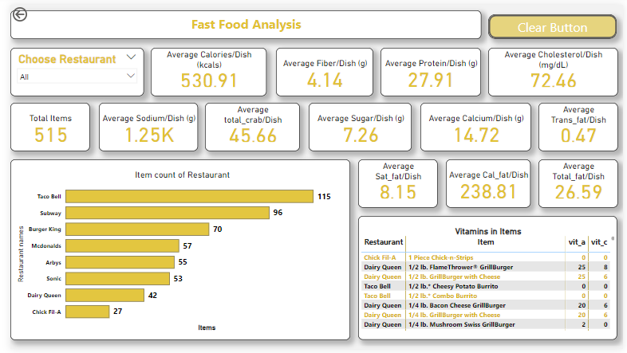
Dashboard

Slide 9
Report
Complaint Diagnostic Report

Slide 10
Thank You !

